Slide 1

Augmentation
Notes:
‹#›

Slide 2
Objectives
Recognize the impact of adding image augmentation to the training process, particularly in time
Demonstrate overfitting or lack of by plotting training and validation accuracies
Familiarize with the ImageDataGenerator parameters used for carrying out image augmentation
Learn how to mitigate overfitting by using data augmentation techniques
Augmentation- avoid overfitting
‹#›

Slide 3
Data Augmentation
Augmentation is a technique used in machine learning, particularly in the context of training deep neural networks, to avoid overfitting.
Overfitting occurs when a model learns to perform well on the training data but fails to generalize to new, unseen data.
Augmentation introduces variations to the training data by applying random transformations, such as rotation, scaling, flipping, or cropping, to create new training examples.
Augmentation- avoid overfitting
‹#›
Notes:
‹#›

Slide 4
Data Augmentation
The key idea behind data augmentation is to increase the diversity of the training set without collecting additional labeled examples..
For example:
In image classification tasks, data augmentation might involve randomly rotating, scaling, or flipping images during training.
In natural language processing tasks, text augmentation techniques could include synonym replacement, word shuffling, or introducing small perturbations to the input text..
Augmentation- avoid overfitting
‹#›
Notes:
‹#›

Slide 5
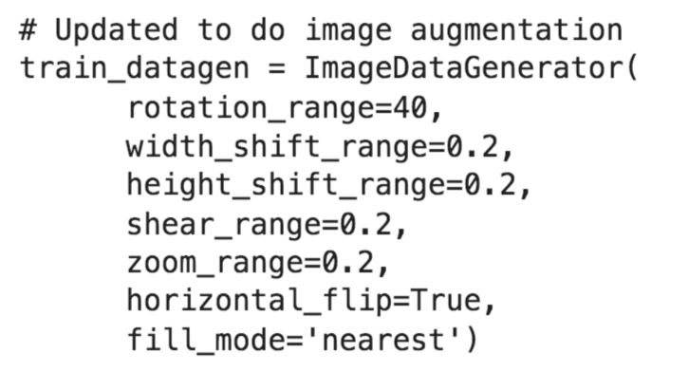
Data Augmentation
Augment the image
→ discuss the augmentation technologies
Augmentation- avoid overfitting
‹#›
Notes:
‹#›

Slide 6
Data Augmentation
rotation_range is a value in degrees (0–180) within which to randomly rotate pictures.
width_shift and height_shift are ranges (as a fraction of total width or height) within which to randomly translate pictures vertically or horizontally.
shear_range is for randomly applying shearing transformations.
zoom_range is for randomly zooming inside pictures.
horizontal_flip is for randomly flipping half of the images horizontally.
fill_mode is the strategy used for filling in newly created pixels, which can appear after a rotation or a width/height shift.
Augmentation- avoid overfitting
‹#›
Notes:
‹#›

Slide 7
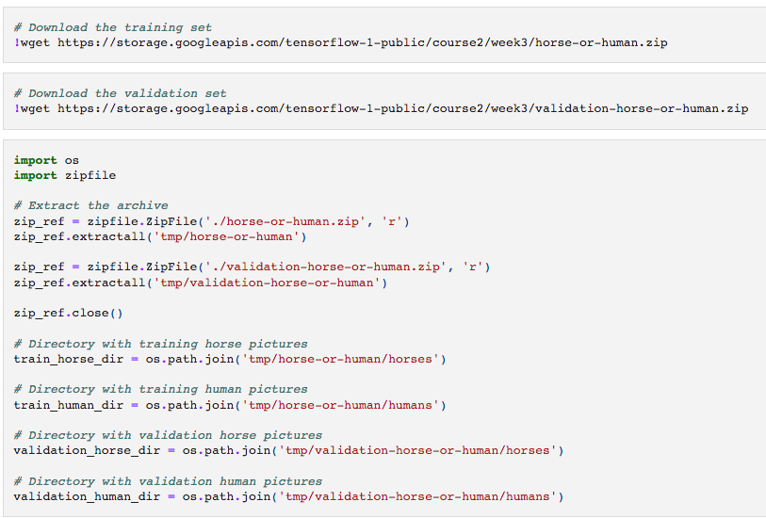
Create model
Augmentation- avoid overfitting
‹#›
Notes:
‹#›

Slide 8
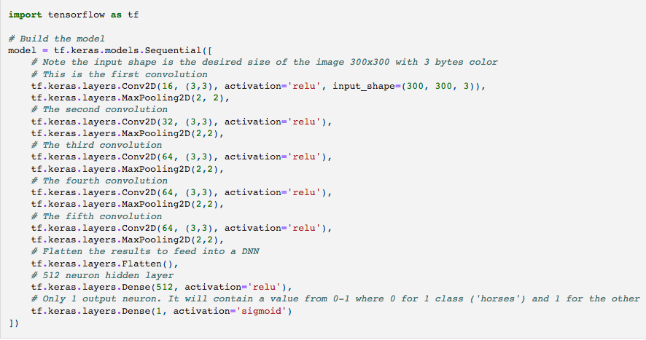
Create model
Augmentation- avoid overfitting
‹#›
Notes:
‹#›

Slide 9
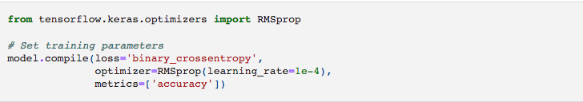
Create model
Augmentation- avoid overfitting
‹#›
Notes:
‹#›

Slide 10
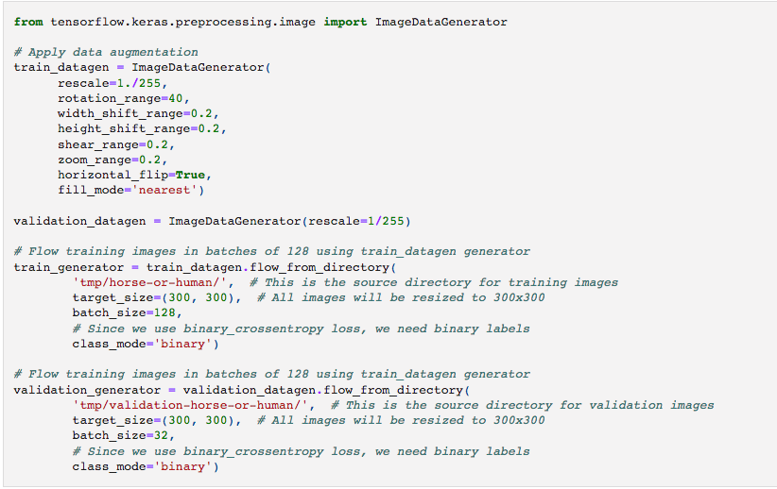
Create model
Augmentation- avoid overfitting
‹#›
Notes:
‹#›

Slide 11
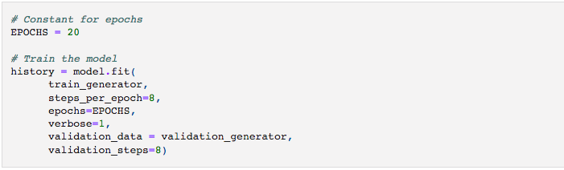
Create model
Augmentation- avoid overfitting
‹#›
Notes:
‹#›

Slide 12
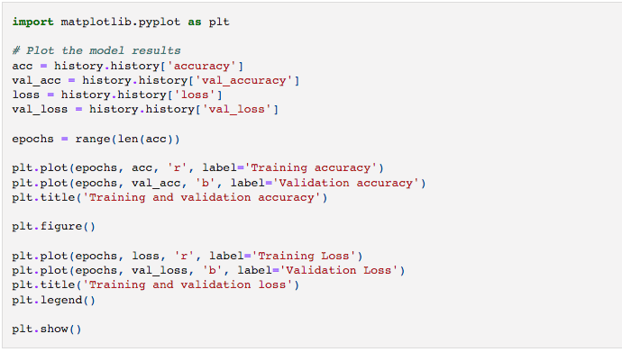
Create model
Augmentation- avoid overfitting
‹#›
Notes:
‹#›

Slide 13
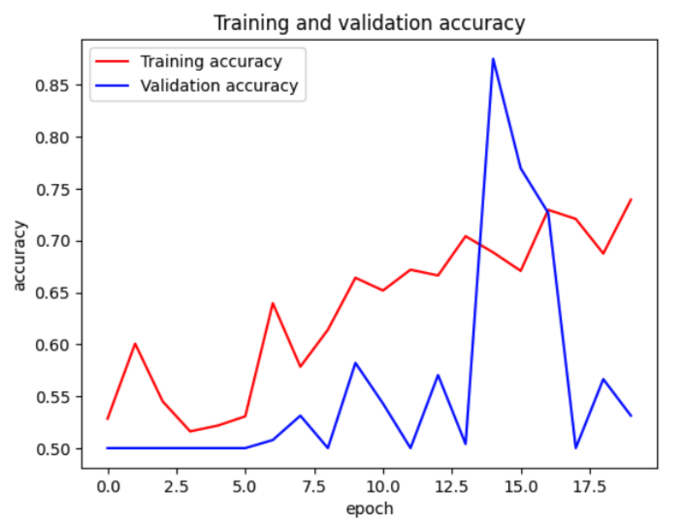
Create model
Augmentation- avoid overfitting
‹#›
Notes:
‹#›

Slide 14
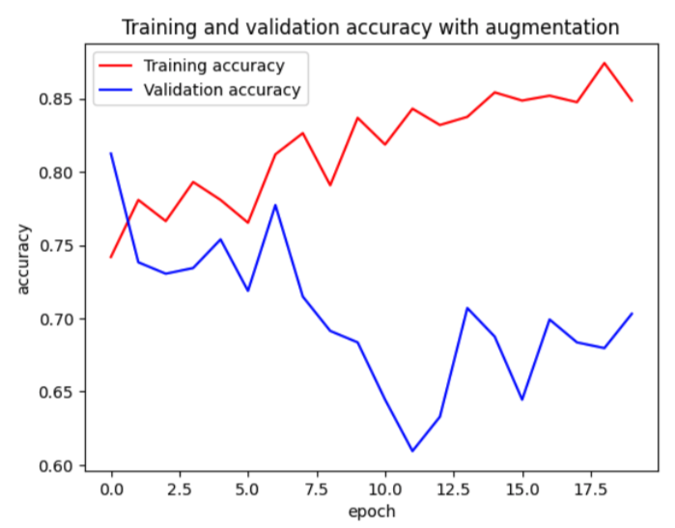
Create model
Augmentation- avoid overfitting
‹#›
Notes:
‹#›

Slide 15
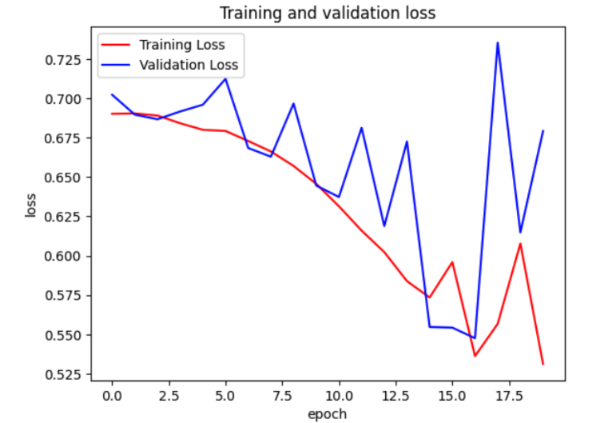
Create model
Augmentation- avoid overfitting
‹#›
Notes:
‹#›

Slide 16
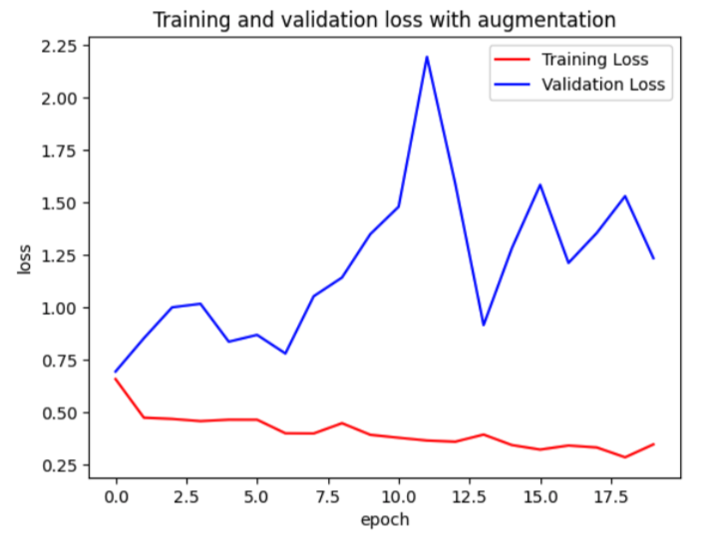
Create model
Augmentation- avoid overfitting
‹#›
Notes:
‹#›

Slide 17
Summary
Recognize the impact of adding image augmentation to the training process, particularly in time
Demonstrate overfitting or lack of by plotting training and validation accuracies
Familiarize with the ImageDataGenerator parameters used for carrying out image augmentation
Learn how to mitigate overfitting by using data augmentation techniques
Augmentation- avoid overfitting
‹#›

Slide 18
Q & A
Augmentation- avoid overfitting
‹#›

